Slide 1
SQL Server Internals Overview

Slide 2
Overview
A quick dive into the SQL Server Architecture
The three main resources SQL Server uses
CPU
Memory
I/O

Slide 3
Major Components
Relational Engine
Command Parser
Checks your syntax
Query Optimizer
Determines how to best get the data
Query Executor
Dispatches commands to the Storage Engine

Slide 4
Major Components
Storage Engine
Access Methods
Determines pages and indexes to use
Buffer Manager
Manages disk I/O functions to & from cache
Transaction Manager
Ensure ACID properties
Atomicity
Consistency
Isolation
Durability
Notes:
ACID Properties
Atomicity – All or nothing transaction – if part fails, all fails
Consistency – Ensure data written to DB is valid according to defined rules, like Fkeys, restraints, datatype, etc.
Isolation – Ensure concurrent execution of transaction results as if done serially
Durabiity – Once txn is committed, it will remain so, even if power loss, etc.

Slide 5
Major Components
Memory
Buffer Pool
Memory allocated for SQL Server
Plan Cache
Stored execution plans for re-use
Data Cache
Stores data pages for re-use

Slide 6
Major Components
Transaction Log
Sequentially stores the transactions that change the DB
Data Files
Store the DB on disk

Slide 7
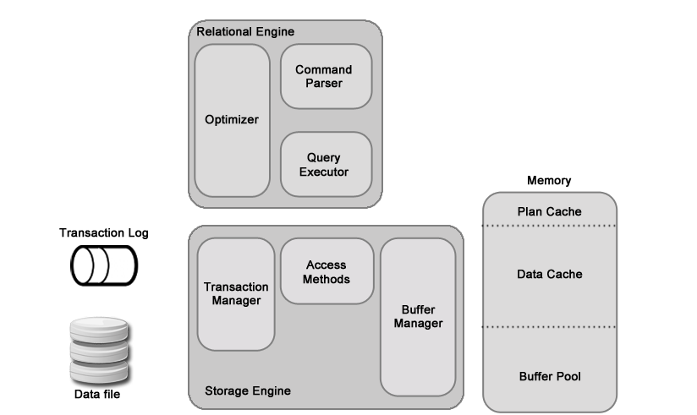
Main Components in Action
A
Simple
Update
A
Simple
Query
T-SQL
Output
Notes:
First a SQL command, in this case a simple query such as ‘select top 10 * from the address table’, is passed to the Command parser in the relational engine
The command parser first checks the syntax of the query.
If there is an issue, the process stops and you receive a syntax error from the query engine.

Slide 8
Pages
Fundamental unit of data storage
8KB in size
128 pages / MB
96 byte header
Page number
Page type
Amount of free space
Rows cannot span pages
Portions moved off the row page to allow larger values

Slide 9
Extents
Basic unit in which space is managed
8 physical contiguous pages
64 KB
16 Extents / MB
Uniform
Owned by a single object
Uses all 8 pages
Mixed
Shared by up to 8 objects

Slide 10
Dirty Pages
Has changed in memory since it was loaded from disk
WITH NOLOCK
Bad practice
Reads dirty pages
Potentially inaccurate
Lack of locking protection for transaction
Can cause errors when data changes
Page splitting can cause issues too

Slide 11
LazyWriter
Checks the free buffer list
Ages out pages to keep space for new pages
Manages SQL Server available memory
If dirty pages found
If not in use / used recently
Flushed to disk first
Marks free in memory

Slide 12
Page Splitting
Expected behavior
When inserting or updating rows
No space on page for new row
Move rows to another page to make room
Leads to fragmentation in tables and indexes
Page 79
Page 294
1.5
1
2
3
2
3

Slide 13
Main Resources - CPU
SQL Engine Usage
Compression
Bulk Load operations
Compiling and recompiling queries
Execution of CPU-intensive query operations (aggregations)
Traces, Encryption
Other Services
SQL Agent
Antivirus

Slide 14
Main Resources - CPU
CPU Control (safe methods)
Manage running services
Multiple instances
Virtualization
Optimize your code
Notes:
There are steps that can be taken that are of relatively low risk to implement that can help ease pressure on the CPU.
Be sure to manage services running in the server. Extra services that are not required can quickly rob the SQL Server of CPU power that it needs.
Maybe there are multiple instances of SQL Server installed on your machine. Each instance will by vying for the same CPU resources.
Virtualization goes one step further and there is a risk of sharing the CPU resources with other servers that are running CPU intensive processes.
Finally, review any SQL code for inefficiencies and CPU intensive query operations.
More often than not a lot of CPU pressure can be eased by properly writing SQL code.
Proper index usage, query plan reuse, etc. all help.
Optimize SQL code –
This should be obvious, but by properly writing SQL code the CPU usage can be minimized freeing it up for use by other SQL processes.
Proper index usage, query plan reuse, etc. all help to ease the CPU pressure.

Slide 15
Main Resources - CPU
CPU Control (risky)
Max worker threads
Max Degree of Parallelism
CPU & I/O affinity
Notes:
The configuration of SQL Server out of the box in respect to CPU usage is pretty good.
There are some advanced options that experienced DBAs can use to fine tune SQL only if required.
Some of these are:
Max Worker Threads –
SQL Server uses the native thread services of MS Server
Thread pooling helps to optimize performance when large numbers of clients are connected to the server such as in an OLTP situation.
SQL Server is already configured to handle the majority of situations.
This is an advanced option and should only be changed by an experienced DBA.
Max degree of parallelism –
This option controls the number of processors that are used for execution of a query with parallel plans.
The setting determines the computing and thread resources that are used for the query plan operators.
This can be controlled within a query statement with a query hint, or configured at the server level.
The default value is zero (0) which allows SQL Server to use all processors when performing any parallel query processes.
**** Demo the lookup and setting of the value (Demo this in a statement, and show the value at the server level)
CPU & I/O affinity –
The Affinity settings allow SQL Server to move schedulers and lazywriters between processors automatically.
By changing values you run the risk of ‘locking’ SQL to specific CPUs and creating issues if those CPUs get too taxed.
There are only a handful or so of known cases where changing these settings has actually been warranted & improved performance.
In a very large majority of cases these settings should not be changed.

Slide 16
Main Resources - Memory
Memory
Procedure cache (Plan cache)
Buffer cache (Data cache)
Logical I/O versus physical I/O
Lock Pages in Memory
Other memory allocation
Notes:
Memory –
Memory is the heart of SQL Server performance.
By storing various parts of the data and optimizations in SQL Server the system can perform at maximum efficiency.
Procedure cache or Plan cache–
The portion of SQL memory that stores query execution plans generated by the optimizer.
The Buffer cache or Data cache:
The portion of SQL memory that stores the data from the disk for quicker access
Logical vs physical IO:
Logical IO is the reading and writing of data that is already in the Data cache
Physical IO is the reading of data from disk to the Data cache to then be accessed by the logical IO process.
Lock pages in memory is a setting that prevents windows from reclaiming a significant amount of the buffer pool memory.
This allows SQL server to better manage the reduction on its own working memory.
There is some debate if this should option should be enabled.
The classic DBA answer of “It Depends” applies here.
Appropriate research and testing should be done before enabling.
Other memory allocation.
Other services and applications running on the SQL Server machine need memory as well, so be sure to take that into account.

Slide 17
Main Resources – I/O
Database data files
Database log files
TempDB
Operating System
Notes:
I/O is usually the first place performance issues with SQL Server wind up being from.
With todays fast CPUs and “cheap” memory it is usually the disk I/O that causes performance bottlenecks.
Knowing how the various files within SQL perform IO will help to determine proper configuration.
Data files are randomly accessed on the drive. Depending on what data is being requested the disk must find the sector then load it to memory.
When reading from data files, if indexes and heaps (tables with no index) are not fragmented the data can be read off sequentially once found.
If the indexes and tables are fragmented, then random reading & writing occurs and performance starts to take a hit.
Database Log Files record the events that happen in sequence in the database.
As such they are always read and written to sequentially.
Because of this it is recommended to separate them from the datafiles on their own dedicated drive.
TEMPDB is a special database on the SQL Server. It has data files and log files just like the other databases.
The main differences are that every other database uses TEMPDB as its scratchpad.
The sorting of data, temp tables & variables, cursors etc. are all stored in this database.
Internal objects that are created by the SQL Server Database engine also use the tempdb.
Due to the high level of activity in the TEMPDB it is highly recommended to place it on its own dedicated disk.
SQL Server by design has reduced logging overhead for the tempdb since each time the SQL Server service is restarted, the tempdb is dropped and recreated.
This helps to reduce the disk io for the tempdb log
Again, there are components on the Server that are not part of SQL Server that affect disk IO.
The operating system should be installed on its own disk as well to help minimize the I/O impact for the data and log files.

Slide 18
Main Resources - Others
Networking
Query / Application usage
SELECT *
SQL Agent usage
SSIS / SSRS usage
Replication / AlwaysOn usage
Notes:
There is one other resource to keep an eye on. Networking.
Usually the DBA does not have a lot of control over network configurations, but there are things that can be watched for.
Keep an eye on query and application use of network bandwidth.
Are there a lot of select * statements in the application moving more data than required around?
Are linked servers being referenced regularly, requiring a trip across the network to another server?
The SQL agent can use network bandwidth as well.
Depending on what types of jobs are being run network usage can be bottlenecked.
Remote calls, copying files and other network actions can be scheduled to run automatically with the agent at critical times.
SSIS / SSRS:
Other components of SQL Server such as SSIS for ETL and other data manipulation and Report Services web interface and email all take up network bandwidth.
Replication / Always on / other HA options.
Moving data to other servers may require a lot of bandwidth as well.
With Always on it is highly recommended to ensure more than 1 nic card is in the server to help alleviate some of the bottlenecking that can occur.
Redundancy is paramount when implementing a High availability solution

Slide 19
@CBELLDBA
Chris@WaterOxConsulting.com
WaterOxConsulting.com
* Stock images from Pexels.com

