Slide 2
Comic from Dilbert.com
Notes:
Who am I?
Founder of WaterOx Consulting – Remote DBA Services and SQL Server Consulting.
Over 18 yrs experience with SQL Server
Member of: PASS, Toastmasters, Data Management international and a Microsoft partner & Bizspark (someone at MS thinks I have a good idea)
Member of the data werewolves on Linked in

Slide 3
Agenda
Scenarios of data exposure
Data in transit vs. Data at rest
Discuss personal experience
Hash or Encryption – How to choose?
Demo #1
Discuss how to improve
Demo #2
Final summary and questions
http://reedbookmanreunion.com/images/agenda.jpg

Slide 4
50 million users
may have been compromised
Name, email, address, “encrypted” passwords
Notes:
April 2013 – Just a couple of weeks ago
Salted hashed passwords using SHA1 algorithm.
SHA1 was found to not be truly secure in 2005,
Living Social began in 2007.

Slide 5
4.7 million SSN
3.3 million bank account #s
Notes:
Oct 2012
- SC Dept of Revenue announces that 4.7million SSNS of tax filers and dependents stolen
- Compliant with IRS rules.

Slide 6
“While encryption of data at rest is an effective defense-in-depth technique, encryption is not currently required for FTI (Federal Tax Information) while it resides on a system (e.g., in files or in a database) that is dedicated to receiving, processing, storing or transmitting FTI, is configured in accordance with the IRS Safeguards Computer Security Evaluation Matrix (SCSEM) recommendations and is physically secure restricted area behind two locked barriers. This type of encryption is being evaluated by the IRS as a potential policy update in the next revision of the Publication 1075.”
Data at rest is not required to be encrypted
http://www.irs.gov/uac/Encryption-Requirements-of-IRS-Publication-1075
Notes:
“While encryption of data at rest is an effective defense-in-depth technique, encryption is not currently required for FTI (Federal Tax Information) while it resides on a system (e.g., in files or in a database) that is dedicated to receiving, processing, storing or transmitting FTI, is configured in accordance with the IRS Safeguards Computer Security Evaluation Matrix (SCSEM) recommendations and is physically secure restricted area behind two locked barriers. This type of encryption is being evaluated by the IRS as a potential policy update in the next revision of the Publication 1075.”

Slide 7
94 million credit cards
Notes:
Dec 2006
Due to lack of firewalls and weak encryption
Hard to grasp the extent of the data exposed

Slide 8
Notes:
If everyone in the USA had 1 credit card – that would be 1 in 3 people who’s card number was exposed.

Slide 9
Notes:
Why bother to encypt data at rest?

Slide 10
Data in Transit
Notes:
Data in transit
Thousands of prospectors panning for gold in a fast flowing river

Slide 11
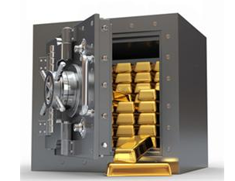
Data at Rest
Notes:
Corporate DB = Mountains of data gold in one location.
How much confidential information do you have at work”
Credt cards
Ssns
Confidential employee data
Contracts
Purchase orders
Medical records
financials

Slide 12
http://www.petapixel.com/assets/uploads/2009/12/Storybook-Wolf-by-Jose-Lu-0011.jpg
Notes:
Just because there is a fence, doesn’t mean you’re safe
Just because you lock the gate doesn’t mean you are safe

Slide 13
Change is coming
Notes:
As mentioned earlier, change is coming
Need to prepare for the upcoming storm

Slide 14
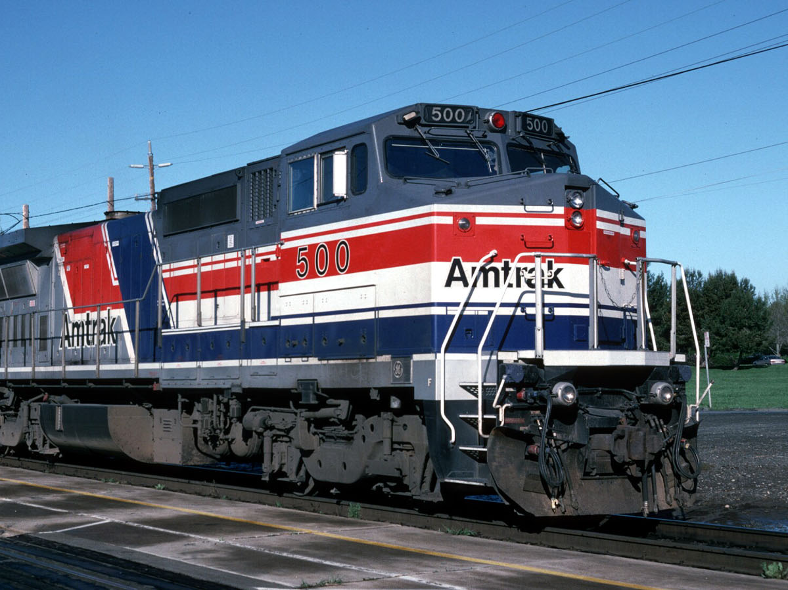

Slide 15
Data at object level had to be protected
Had to be able to decrypt the value
No change to existing application code, SQL code ok
Minimal Impact on performance
http://shawnram.files.wordpress.com/2010/10/criteria1.jpg
Notes:
http://www.thephatstartup.com/wp-content/uploads/2012/08/dont-worry-i-got-this.jpg

Slide 16
http://www.thephatstartup.com/wp-content/uploads/2012/08/dont-worry-i-got-this.jpg
Notes:
http://www.thephatstartup.com/wp-content/uploads/2012/08/dont-worry-i-got-this.jpg

Slide 17
What method?

Slide 18
Transparent Data Encryption?
Does:
Encrypt the MDF and LDF files via symmetric key
Encrypt files and trans log for log shipped / mirrored
Affect performance since tempdb is encrypted too
Does not:
encrypt data at the object level.
support instant file initialization for database files.
interact well with backup compression.
encrypt read only filegroups.
encrypt databases used in replication topologies.
encrypt filestream data.
Notes:
does
encrypt the data "At rest", the actual files themselves are encrypted via a symmetric database encryption key usually protected by an asymmetric key or a certificate.
encrypt database files (data and log) and transaction log records for log shipped and mirrored databases.
affect performance for non encrypted databases on the same instance due to addition of the encrypted TempDB.

Slide 19
Data at object level had to be protected
Had to be able to decrypt the value
No change to existing application code, SQL code ok
Minimal Impact on performance
http://shawnram.files.wordpress.com/2010/10/criteria1.jpg
Notes:
http://www.thephatstartup.com/wp-content/uploads/2012/08/dont-worry-i-got-this.jpg

Slide 20
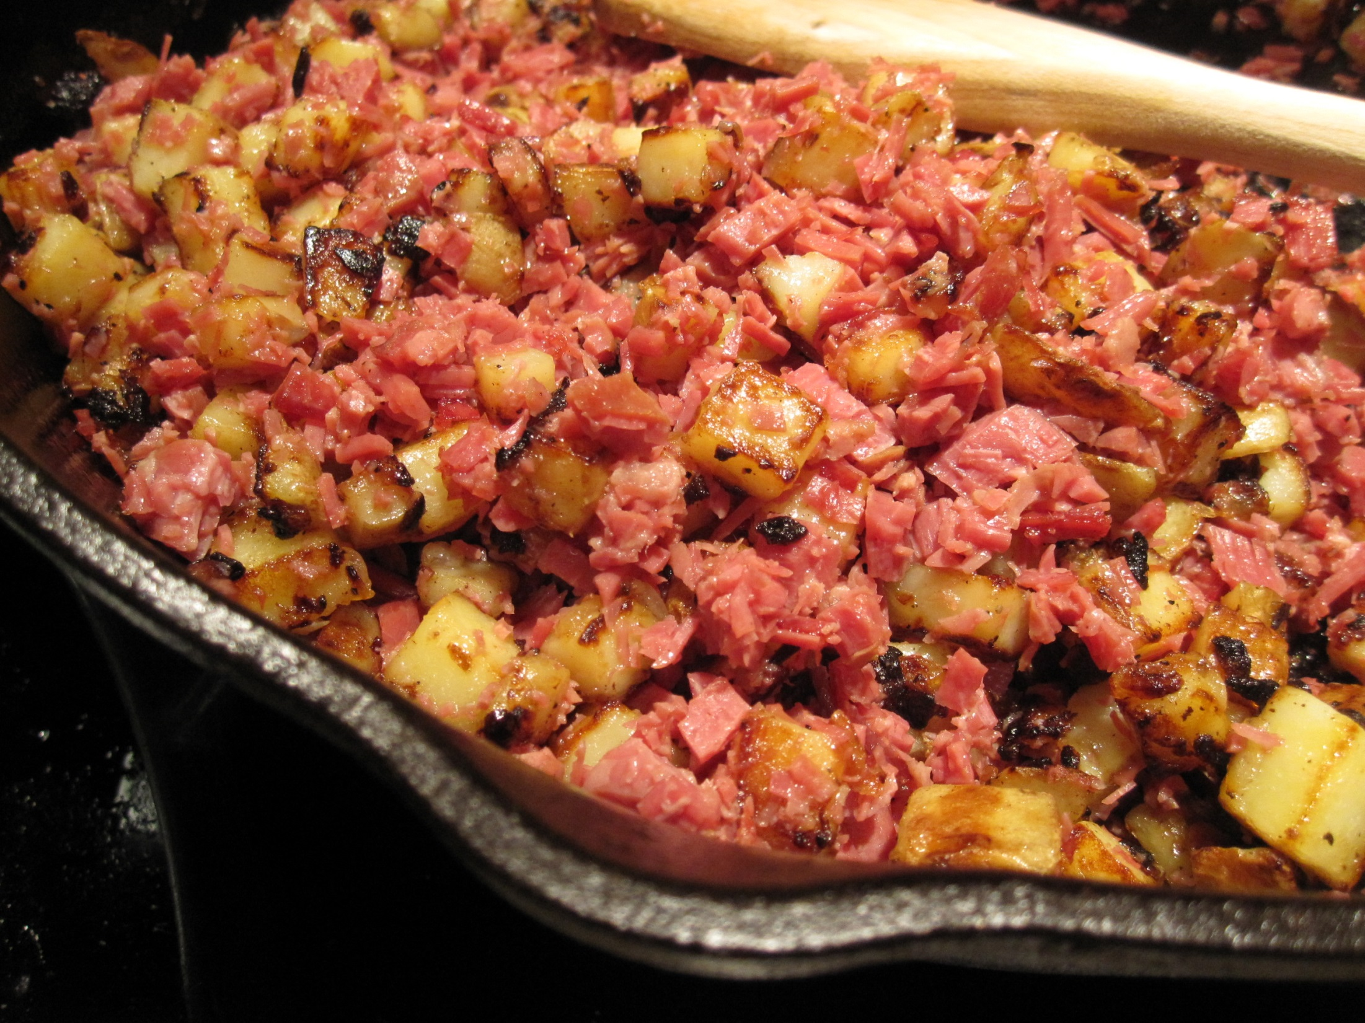
HASH!!
http://www.thesouthinmymouth.com/wp-content/uploads/2012/01/corned-beef-hash.jpg
Notes:
Hashing is taking a variable length string and ‘hashing’ it to a fixed length of gibberish consistently.
Always will hash to the same value
Some things to be aware of when hashing

Slide 21
Salt your Hashes
http://www.f1online.pro/en/image-details/4832529.html
Notes:
Salting a hash means adding a value in it to make attacks by hackers harder for them.

Slide 22
http://kingdombard.files.wordpress.com/2010/06/one_way_by_cellogirl19.jpg
Notes:
Hashing is 1 way only.
There is no ‘unhashing’ a value if you need it later
(ex report, membership card, etc)

Slide 23
Collisions
Notes:
Hashing does run the risk of ‘collisions’
Times where the hashed values for 2 totally different values comes out the same.
Rainbow tables to crack values, etc.
Hashing is like baking bread
Flour water yeast + baking (algorithm) = bread
2 cup flour 1 TBSP yeast vs 1.9 cup flour + .9 TBSP yeast
You can’t tell what made the bread, look the same, taste the same
Can’t undo
Hashing not an option in my situation

Slide 24
Data at object level had to be protected
Had to be able to decrypt the value
No change to existing application code, SQL code ok
Minimal Impact on performance
http://shawnram.files.wordpress.com/2010/10/criteria1.jpg
Notes:
http://www.thephatstartup.com/wp-content/uploads/2012/08/dont-worry-i-got-this.jpg

Slide 25
Encryption
Notes:
Pretty powerful and complex
Non-determinite
Different everytime you encrypt the value (non-deterministic)
The keys are what make it possible

Slide 26
Notes:
Encryption goes both ways – encrypt and decrypt
Can easily get the values so long as I have access to the keys

Slide 27
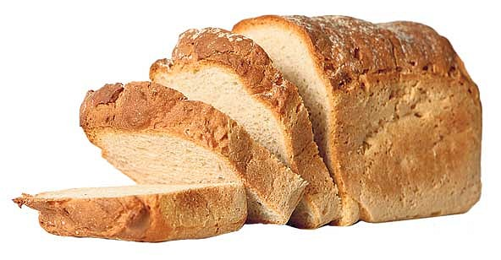
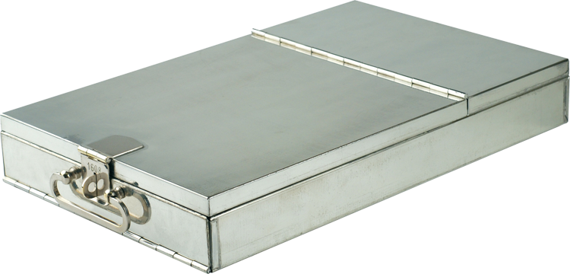
http://www.swiss-banking-antiques.com/images/bbposte60mmperspective-750.png
http://cdn.zmescience.com/wp-content/uploads/2012/12/fresh-sliced-bread.jpg

Slide 28
DEMO
Notes:
Show values – search on encrypted
Show table scan, then index scan

Slide 29
Data at object level had to be protected
Had to be able to decrypt the value
No change to existing application code, SQL code ok
Minimal Impact on performance
http://shawnram.files.wordpress.com/2010/10/criteria1.jpg
Notes:
http://www.thephatstartup.com/wp-content/uploads/2012/08/dont-worry-i-got-this.jpg

Slide 30
Options?
http://www.miamism.com/wp-content/uploads/m/blogs/miamism/options.jpg
Notes:
What options do we have?

Slide 31
xxx-xx-1287
Notes:
Common practice to expose part of the data being searched
‘Partial Plaintext Value’
Ex: last 4 of SSN
issue: I have given part of the encrypted value to anyone that gets a hold of my data.
They look for that pattern to get a subset to then focus on
Reduce time and effort to then crack the cipher

Slide 32
Hash Grouping
Generate a value
From a hash algorithm
and store only the end
result value.
http://kennybriscoe.com/wp-content/uploads/2011/02/lightbulb-idea.jpg
Notes:
Don’t want to store the hash – why bother to encrypt unless to undo – overkill and overwork
“Simplify”
We know the hashing is deterministic – take that value, divide it to get a grouping value, then store that.
Gives no hint what-so-ever to the actual hashed value
- Create index on the hashgroup value

Slide 34
Data at object level had to be protected
Had to be able to decrypt the value
No change to existing application code, SQL code ok
Minimal Impact on performance
http://shawnram.files.wordpress.com/2010/10/criteria1.jpg
Notes:
http://www.thephatstartup.com/wp-content/uploads/2012/08/dont-worry-i-got-this.jpg

Slide 35
SUCCESS!
http://www.smallbiztechnology.com/wp-content/uploads/2012/12/success.jpg

Slide 36
No Perfect Solution
New GPU systems
crack 14 character passwords
in about 6 minutes
Potential breaking times of various Hash Algorithms:
SHA1: 63G / sec
LM: 20G / sec
Bcrypt: 71k /sec
*Not been able to find stats for AES_256 (SQL Encryption)
because no one is really bothering to try
http://www.club-3d.com/tl_files/club3d/uploads/en/content/Technology/AMD/CrossFireX/3waycrossfire.png
Notes:
True encryption hacking in a reasonable amount of time would require quantum computers, not readily available to hackers.

Slide 37
Brace Yourselves
Change is coming.
http://imgix.8tracks.com/mix_covers/000/593/175/94743.original.jpg?fm=jpg&q=65&sharp=15&vib=10&w=521&h=521&fit=crop
Notes:
True encryption hacking in a reasonable anount of time would require quantum computers, not readily available to hackers.

Slide 38
@CBELLDBA
Chris@WaterOxConsulting.com
www.WaterOxConsulting.com
Image by: Master isolated images on www.freedigitalphotos.net
Notes:
How to contact me

